Slide 1

Independent Component Analysis:
Algorithms and Applications
ICT&QCF 2019
May 22nd, 2020

Slide 2
Outline
Introduction, definition of ICA, Statistical independence
Principal of ICA
Preprocessing the data
FastICA Algorithm
Applications of ICA

Slide 3
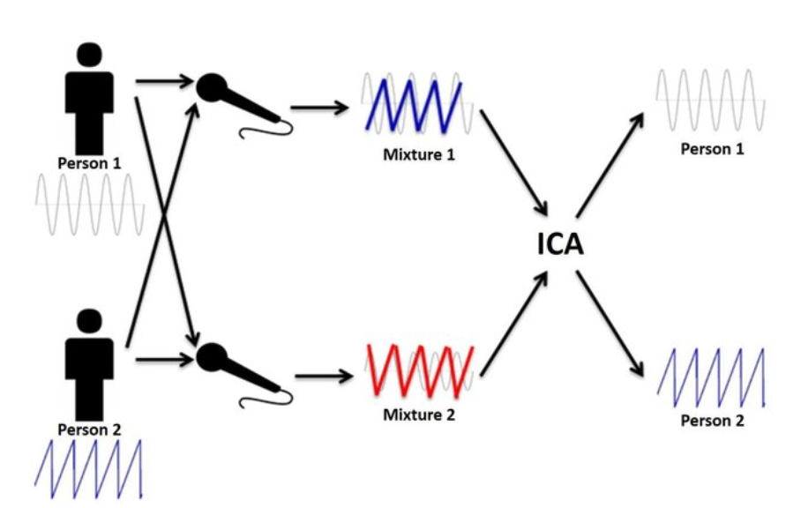
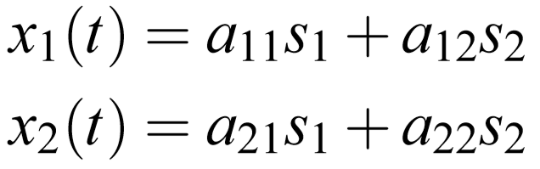
Motivation
Notes:
A: parameters that depend on the distances of the microphones from the speaker
S: a weighted sum of the speech signals

Slide 4
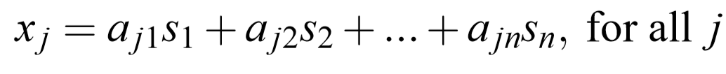
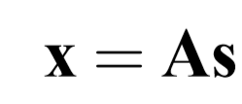

The definition of ICA
Assume that we observe n linear mixtures x1,...,xn of n independent components
After estimating the matrix A, we can compute its inverse, say W, and obtain the independent component simply by:

Slide 5
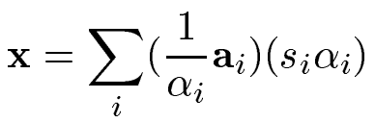
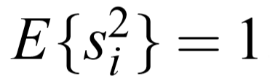
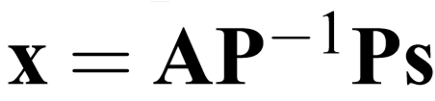
Ambiguities of ICA
1. We cannot determine the variances of the independent components.
Any scalar multiplier in one of the sources si could always be canceled by dividing the corresponding column ai of A by the same scalar, say i:
As a consequence, the most natural way to do this is to assume that each has unit variance: Then the matrix A will be adapted in the ICA solution methods.
2. We cannot determine the order of the independent components.
Formally, a permutation matrix P and its inverse can be substituted in the model to give:
Notes:
. Then the matrix A will be adapted in the ICA solution methods to take into account this restriction.
We can freely change the order of the terms in the sum, and call any of the independent components the first one. The elements of Ps are the original independent variables sj, but in another order. The matrix AP is just a new unknown mixing matrix, to be solved by the ICA algorithms

Slide 6
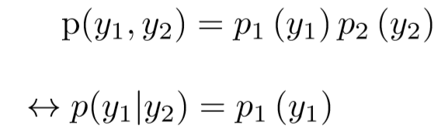
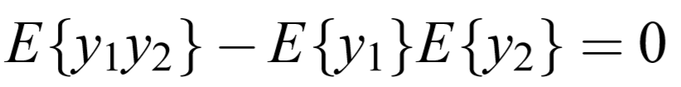
Independence definition and its properties
y1 and y2 are independent if and only if the joint pdf is factorizable in the following way:
Two random variables y1 and y2 are said to be uncorrelated, if their covariance is zero:
Since independence implies uncorrelatedness, many ICA methods constrain the estimation procedure so that it always gives uncorrelated estimates of the independent components. This reduces the number of free parameters, and simpliﬁes the problem.

Slide 7
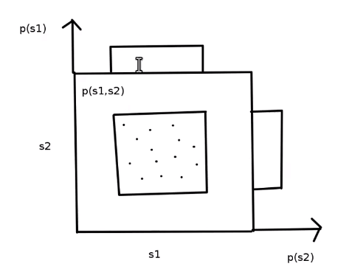
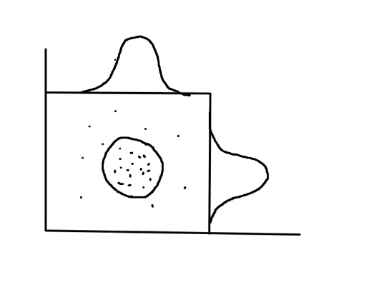




Why Gaussian variables are forbidden?
The fundamental restriction in ICA is that the independent components must be nongaussian for ICA to be possible

Slide 8
Principle of ICA Estimation
Three popular methods:
Maximization of non-Gaussianity: motivated by the central limit theorem, uses kurtosis and negentropy.
Minimization of mutual information
Maximum Likelihood Estimation.
Notes:
In ICA, the goal is to find the unmixing matrix (W) and then projecting the whitened data onto the matrix for extracting independent signals. This matrix can be estimated using three main approaches of independence, which results in slightly different unmixing matrices. The first is based on the non-Gaussianity. This can be measured by some methods such as kurtosis, and negentropy. In the second approach, the ICA goal can be obtained by minimizing the mutual information. Additionally, ICA can be also estimated by using maximum likelihood estimation (MLE).
All approaches simply search for a rotation on unmixing matrix W. Projecting the whitened data onto the rotation matrix extracts independent signals. The preprocessing steps are calculated from the data, but the rotation matrix is approximated numerically through an optimization procedure. Searching for the optimal solution is difficult due to the local minima exists in the objective function. In this section, different approaches are introduced for extracting independent components.

Slide 9



Non-gaussianity Estimation
Consider a linear combination of the xi, let’s denote this by y
where w is a vector to be determined, and it’s one row of the inverse of A.
Define , we have:
→ y is more Gaussian than any of the s_i, and it is least Gaussian (i.e. nonguassian) if it is equal to one of the s_i
Maximizing the non-Gaussianity of y to give us one of the independent components.

Slide 10

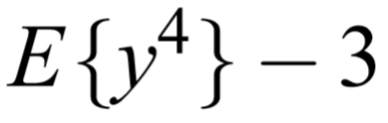

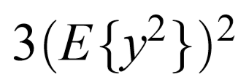
Measures of nongaussianity - Kurtosis (fourth-order cumulant)
Indicates how peaky the distribution is
Assume y is of unit variance, the right-hand side simpliﬁes to
Linearly properties:
Fourth moment: =>The kurtosis for a Gaussian is zero
Notes:
its simplicity, both computational and theoretical
However Kurtosis is very sensitive to outliers when its value has to be estimated from a measured sample.

Slide 11
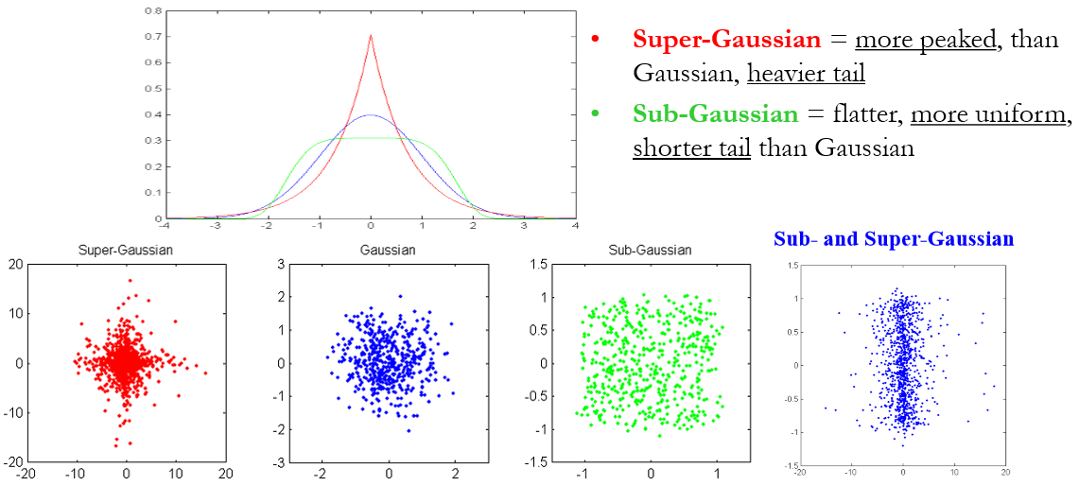
Measures of nongaussianity - Kurtosis

Slide 12
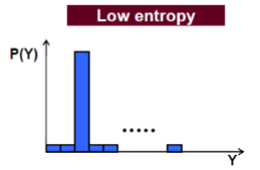
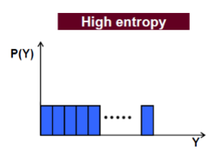


Measures of nongaussianity - Negentropy
The differential entropy H of a random vector y with density f(y) is defined as
(Cover and Thomas, 1991; Papoulis, 1991).
(1)
Gaussian distribution has the largest entropy among all random variables (rv) of equal variance over the entire real axis
Notes:
Continue to introduce the Principle of ICA Estimation.
A second very important measure of non-gaussianity, apart from kurtosis, is given by negentropy. Negentropy is stand for negative entropy, based on the differential entropy. As u know, The differential entropy H is defined as formula (1).
Looking at the chart on slide, Entropy is small for distributions that are clearly concentrated on certain values. In contrast, that is higher.
Morever, Gaussian distribution has the largest entropy among all random variables (rv) of equal variance over the entire real axis . so that, using entropy we can measure the gaussianity.
In fact, entropy is widely use in various methods of ICA estimation

Slide 13


Measures of nongaussianity - Negentropy
Negentropy J (negative entropy) is deﬁned as follows
(2)
where is a Gaussian rv of the same covariance matrix as y.
Negentropy is always non-negative and it is zero if and only if y has a Gaussian distribution.
Notes:
Next like, To obtain the measurement, using Negentropy J is deﬁned as formula 2 . Negentropy is always non-negative and it is zero if and only if y has a Gaussian distribution. And So we aim to maximize the entropy to order y is non-gaussianity as much as possible.
The problem however,that it is difficult for calculation. Therefore, simpler approximations of negentropy are very useful, as will be discussed in next slide.
The advantage of using negentropy, is that it is well justiﬁed in some sense the optimal estimator of nongaussianity,

Slide 14



Approximations of negentropy
The classical method of approximating negentropy is using higher-order moments, for example as follows (Jones and Sibson, 1987):
(3)
(Hyvärinen, 1998b) proposed another methods based on the maximum-entropy principle:
(4)
only use one nonquadratic function G:
(5)
. → maximize J(y) means maximize E {G(y)}
Notes:
But the trick here is that we have to choose G wisely
Classical(1987): y is assumed to be of zero mean and unit variance. However, the validity of such approximations may be rather limited from the nonrobustness encountered with kurtosis.
Hy-1998: : where ki are some positive constants, and ν is a Gaussian variable of zero mean and unit variance (i.e., standardized). The variable y is assumed to be of zero mean and unit variance, and the functions Gi are some nonquadratic functions (Hyvärinen, 1998b).
Note that even in cases where this approximation is not very accurate, (4) can be used to construct a measure of nongaussianity that is consistent in the sense that it is always non-negative, and equal to zero if y has a Gaussian distribution.
In the case where we use only one nonquadratic function G, the approximation becomes (5). Because of G(v) is constant . maximize J(y) means maximize E {G(y)}.

Slide 15
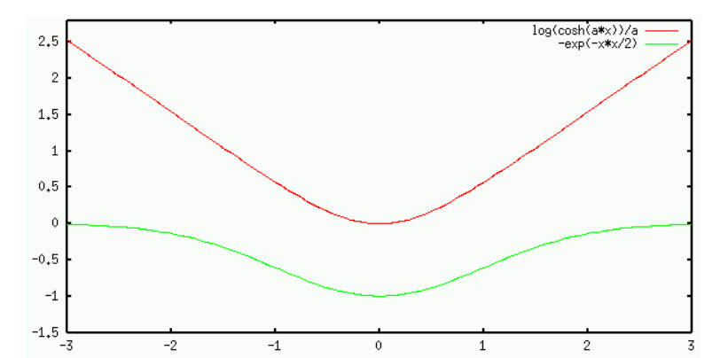

Approximations of negentropy
In particular, choosing G that does not grow too fast. The following choices of G have proved very useful:
(6)
where 1≤ a1 ≤2 is some suitable constant.
Notes:
in particular, choosing G that does not grow too fast, The following choices of G have proved very useful. And we will discuss more details in Fast ICA to find optimal point.
Thus we just obtain approximations of negentropy that give a very good compromise between given by kurtosis and negentropy. They are conceptually simple, fast to compute, especially robustness.
We will next go to other approaches.
G: objective function but simply said it has to be robust to outliers and have a low asymptotic variance.
Practice has proven that G1, a1> 1: good for most use cases, G2: works fine for super-Gaussians ,G3 = u^4: for sub-Gaussian

Slide 16

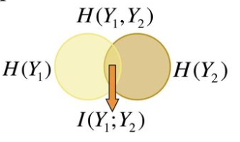

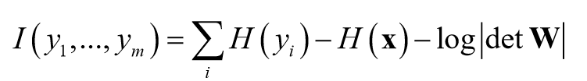
Minimization of Mutual Information
Using the concept of differential entropy, we deﬁne the mutual information I between m (scalar) random variables y (equivalent to Kullback-Leibler divergence):
(7)
Its value is always nonnegative, and zero if and only if the variables are statistically dependent.
→ (8)
→ (9)
Notes:
Another approach for ICA estimation, inspired by information theory, is minimization of mutual information. We will explain this approach here, and show that it leads to the same principle of ﬁnding most nongaussian directions as i have just described above
In ICA, spreading out the points in Y means maximizing the entropy as much as possible.
Using the concept of differential entropy, we deﬁne the mutual information I between m (scalar) random variables y (equivalent to Kullback-Leibler divergence) formula 7
Y = W^ T *X, the Formula (7) is rewrite as 8--> The entropy is changed (increased, decreased) by log W
Where detW: is a notation for a determine of the matrix W,
Assume y is centered & whitened, detW must be constant, introduce this step later in pre-porcessing section.

Slide 17


Minimization of Mutual Information
The fundamental relation between entropy and negentropy is:
(10)
where C: constant, not dependent on W
→ minimize mutual information (I) means maximize negentropy
Notes:
consider the scenario when yi is constrained to be uncorrelated and of unit variance, The fundamental relation between entropy and negentropy is: formula 10 which is more simpler
minimize mutual information (I) means finding directions in which negentropy (a concept related to nongaussianity) is maximized.

Slide 18



Maximum Likelihood Estimation in ICA
The objective is to find an unmixing matrix W that yields extracted signals with a joint pdf as similar as possible to the joint pdf p(i) of the unknown source signals s.
→ (11)
Given T observations of X, the log likelihood of W denoted (Pham et al., 1992):
→ (12)
→ Matrix W maximize the function is the maximum likelihood estimation
Notes:
A very popular approach for estimating the ICA model is maximum likelihood estimation,
The objective is to find an unmixing matrix W that yields extracted signals with a joint pdf as similar as possible to the joint pdf p(i) of the unknown source signals s.
the likelihood in the noise-free ICA model X = As. formula (11)
Given T observations of X, the log likelihood of W denoted, Formula (12) where the pi are the density functions of the si (here assumed to be known), and the x(t),t = 1,...,T are the realizations of x. The term log|detW| in the likelihood comes from the classic rule for (linearly) transforming random variables and their densities
Matrix W maximize the function is the maximum likelihood estimation

Slide 19


Connection to Mutual Information
The log likelihood formula can be simplified:
(14)
The first term (15)
→ the likelihood and mutual information are approximately equal, differ with sign and additive constant.
Notes:
The log likelihood formula can be simplified , formula (14)
the likelihood and mutual information are approximately equal, differ with sign and additive constant., formula (15)
In clusion, It show that MLE is essentially equivalent to minimization of mutual information.
Nevertheless, there is a small difference that may be very important in practice. The problem with maximum likelihood estimation is that the densities pi must be estimated correctly.
.In many cases, in fact, we have enough prior knowledge on the independent components, and we don’t need to estimate their nature from the data. So if the information on the nature of the independent components is not correct, ML estimation will give completely wrong results.
In contrast, using reasonable measures of nongaussianity, this problem does not usually arise.

Slide 20


The Infomax principle
Maximize the output entropy of a neural network with non linear outputs.
(16)
x: input to neural network with the form of output
g_i: some non linear scalar function
w_i: the weight vectors of neuron
→ If the g_i are well chosen → this framework enables ICA estimation
→ maximization mutual information between input and output equals maximization output entropy.
Notes:
Another related contrast function was derived from a neural network viewpoint is infomax. This was based on maximizing the output entropy (or information ﬂow) of a neural network with non-linear outputs.--> maximization mutual information between input and output .
Indeed, several authors proved the surprising result that or “infomax”, is equivalent to maximum likelihood estimation.
Finish introduce 3 popular priciple methods for estimating ICA which are: maximization the non-gaussianity, minimization the mutal information, and maximum likelihood estimation. Next, we will discuss the pre-processing.
Assume that x is the input to the neural network whose outputs are of the form gi(wT i x), where the gi are some non-linear scalar functions, and the wi are the weight vectors of the neurons. One then wants to maximize the entropy of the outputs:
If the gi are well chosen, this framework also enables the estimation of the ICA model. I

Slide 21
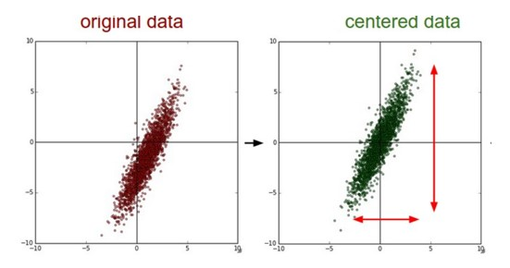
Preprocessing
I. PREPROCESSING
1. Centering
subtracting the mean in each dimension
Notes:
A first step in many ICA algorithms is to centering the data. We need to move the data distribution so that it has the centered at all dimensions.
The original 2-dimensional input data is zero-centered by subtracting the mean in each dimension. The data cloud is centered around the original
This preprocessing is made solely to simplify the ICA algorithms.

Slide 22




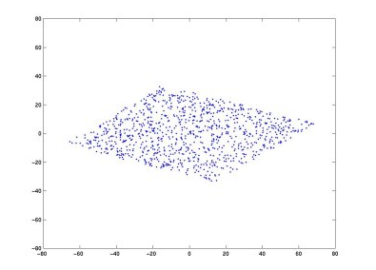
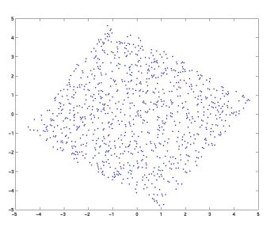
Preprocessing
Whitening
E is the orthogonal matrix of eigenvectors of
D is the diagonal matrix of its eigenvalues
Centered Original
Whited data
Notes:
Next preprocessing. This means that we remove any correlations in the data, i.e. the signals are forced to be uncorrelated. Again putting the words in mathematical terms, we seek a linear transformation V such that when tilde_x = Vx ( in other words we transform the observed vector x linearly so that we obtain a new vector tilde_x ). We now have covariance matrix E{tilde_x, tilde_x_transposed} = I (is identity matrix).
This is easily accomplished by setting V = E*D^{-½} *E^{T} , where E is the orthogonal matrix of eigenvectors of the covariance metric E{x,x_transpose}. And D is the diagonal matrix of its eigenvalues. D = diag(d1, ..dn).
Since then we have E{tilde_x, tilde_x_transposed} = E{Vxx'V'} = I. The figure below shows the signals tilde_x and the joint density p(tilde_x) after such an operation.

Slide 23
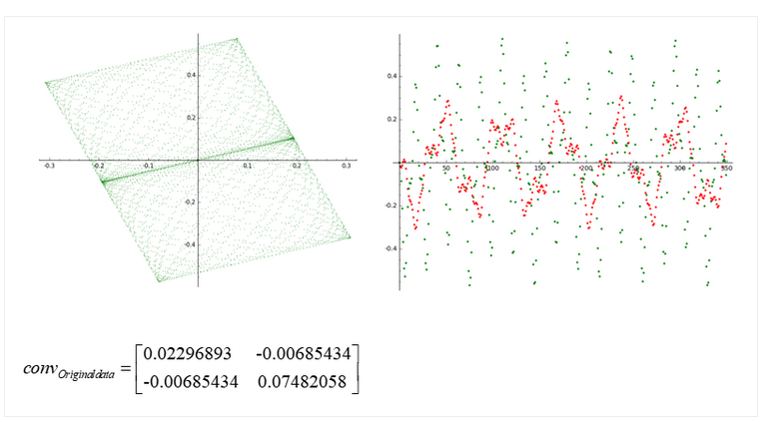
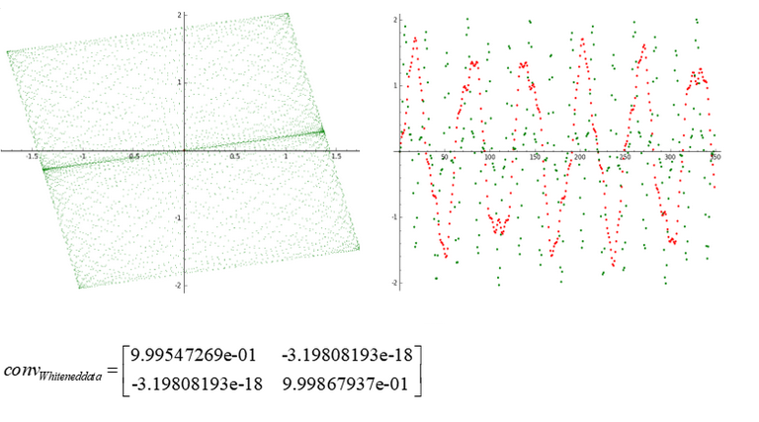
Preprocessing
Subtract the mean in each dimension of data
Find covariance matrix
Decompose using Eigen Decomposition or SVD to get rotation and Scale matrix
Apply the matrices in step 3 to get whitened data
Notes:
We can simplify the preprocessing ICA by 4 steps.
Subtract the mean in each dimension of data
Find covariance matrix
Decompose using Eigen Decomposition or SVD to get rotation and Scale matrix
Apply the matrices in step 3 to get whitened data

Slide 24




The FastICA Algorithm
Negentropy
Ygauss is a Gaussian RV with same variance as Yj. Measures the departure from Gaussianity.
FastICA uses simple approximations to negentropy
and with data replace the first expectation by a sample averages
The derivatives of the functions
Notes:
As mentioned earlier, about the negentropy by Ms Quynh. We can found the derivative of the two functions G

Slide 25
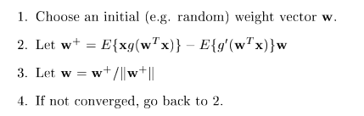
The FastICA Algorithm
FastICA for one unit
FastICA used for extracting one Independent Component is called one-unit, where FastICA finds the weight vector (w) that extracts one independent component.
The basic form of the FastICA algorithm is as follows
ŵ is calculated by approximative Newton iteration
Notes:
After whitening, the separated signals can be found by an orthogonal transformation of the whitened signals tidle_x (this is simply a rotation of the joint density). The appropriate rotation is sought by maximizing the non-normality of the marginal densities. A linear mixture of independent random variables is necessarily more Gaussian than the original variables.
FastICA used for extracting one Independent Component is called one-unit, where FastICA finds the weight vector (w) that extracts one independent component.
The sample point should be chosen separately at every iteration
FastICA has a cubic or at least quadratic convergence speed and hence it is much faster than Gradient-based algorithms that have linear
convergence. Additionally, FastICA has no learning rate or other adjustable parameters which makes it easy to use.

Slide 26


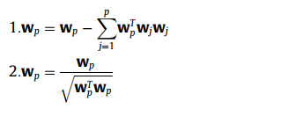
The FastICA Algorithm
FastICA for several units
For estimation several independent components, run the one-unit FastICA algorithm using several units with weight vectors (w1, ...,wn)
The output is decorrelated iteratively with the other outputs which were calculated in the previous iterations ( )
For each iteration, the projections of the previously estimated p-1 vectors, and then renormalize
Notes:
For estimation several independent components, run the one-unit FastICA algorithm using several units with weight vectors w1, ...,wn
Several units of FastICA can be used for extracting several independent components, the output wi is decorrelated iteratively with the other outputs which were calculated in the previous iterations.
We normalize as function below

Slide 27
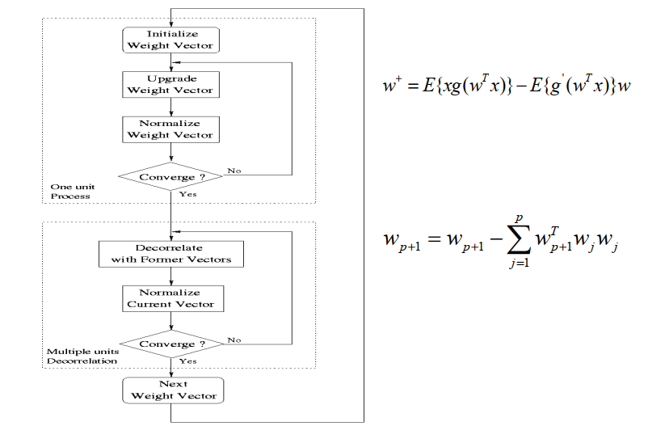

The FastICA Algorithm
2 steps of Fast-ica Algorithm
Notes:
This chart show the combination of 2 steps of the Fast-ICA

Slide 28
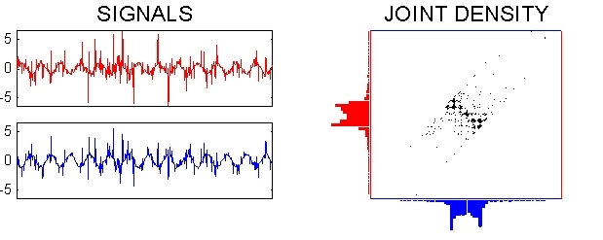
The FastICA Algorithm

Slide 29
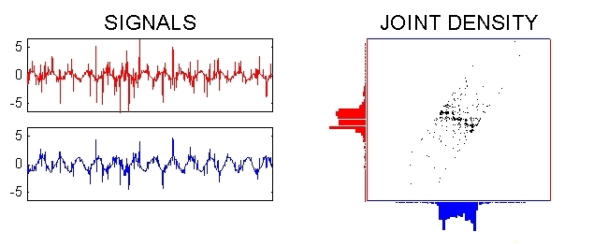
The FastICA Algorithm

Slide 30
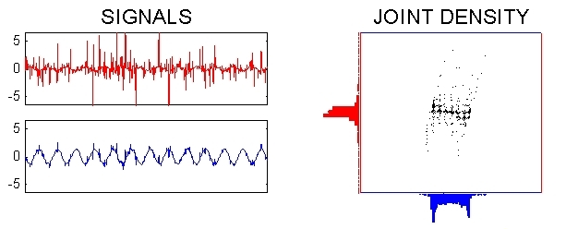
The FastICA Algorithm

Slide 31
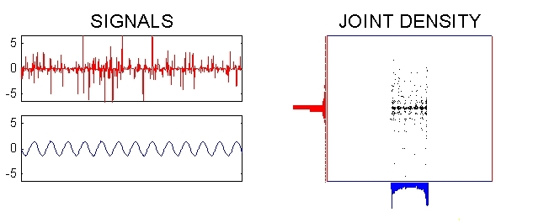
The FastICA Algorithm

Slide 32
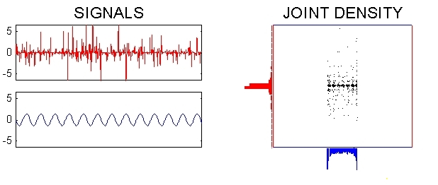
The FastICA Algorithm

Slide 33
Applications of ICA
With the role of separating a multivariate signal into its underlying components, ICA has been applied in different areas such as audio processing, biomedical signal processing, image processing, telecommunications, and econometrics...
Example:
Audio Separation
Separating of Artifacts in Magnetoencephalography (MEG) data.
Finding Hidden Factors in Financial Data.
Reducing Noise in Natural Images.

Slide 34
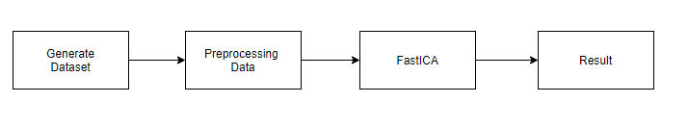
Audio Separation
Denote X is mixing audios (observation), A is mixing matrix, S is underlying components. We have the mixing model is:
X = AS
Let W is inverse matrix of A, we have:
S = WX
Our experiment workflow:

Slide 35
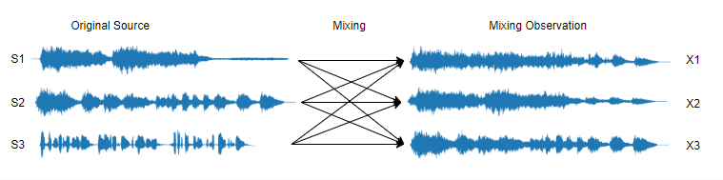
GENERATE DATASET

Slide 36

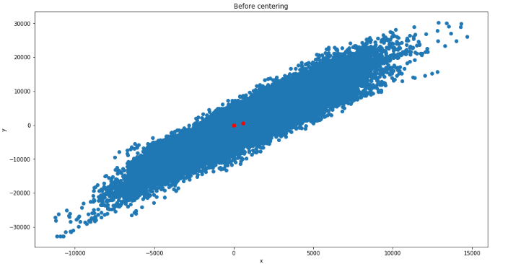

Preprocessing
I. PREPROCESSING
1. Centering

Slide 37
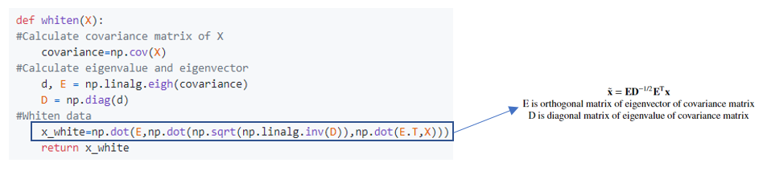
Preprocessing
I. PREPROCESSING
2. Whitening:

Slide 38
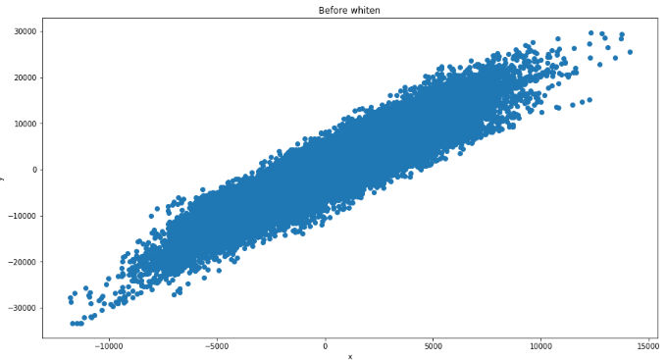
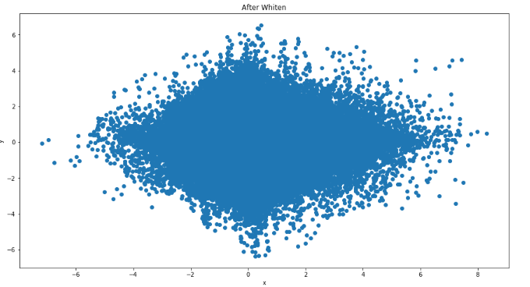

Slide 39
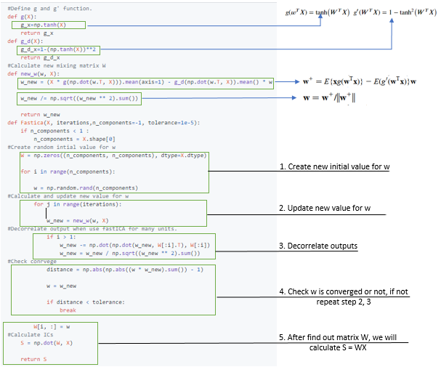
FastICA Algorithm

Slide 40
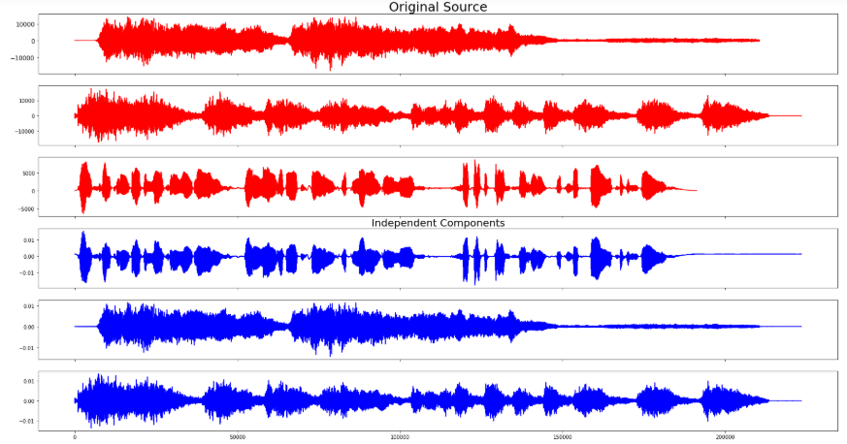
Plot the result
Source code and data are available on: https://github.com/JVN2019/ICA_Linear_Report

Slide 41
THANKS FOR YOUR ATTENTION !

